Slide 1


Educate english
Radoslav Ivanov
Boqn Binev
Raq Lilova
Stivan Lilov
Kaloyan Dimov

Slide 2


The main idea

Slide 3
The process
We considered the idea about our project!
We have allocated the tasks.
We have set a deadline for completing the tasks.
Final changes to the code.

Slide 4





WE Used these programs
Visual Studio
Discord
Github

Slide 5
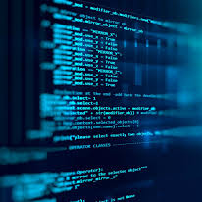
AND NOW WE WILL SHOW YOU OUR PROGRAM HOW IT WORKS

Slide 6

IF YOU HAVE QUESTION YOU CAN ASK US

